Slide 1


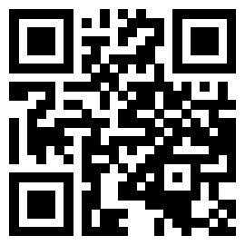
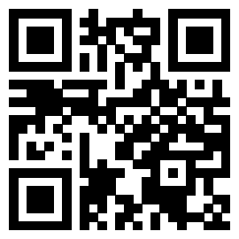
Web Scraping
Join our Slack:
Sign-in:
go.osu.edu/BDAAsignin
go.osu.edu/bdaaslack

Slide 2
Zoom Etiquette & Code of Conduct
Please keep your mic on mute unless talking
Questions are welcome and encouraged at any time! Just please ask in the chat during the presentation
This meeting will be recorded and posted publicly later. By continuing to be in this workshop, you consent to this recording and its publication
BDAA aspires to create a community built on collaboration, innovation, creativity, and belonging within and across disciplines. To inspire, empower, and connect all members -- whatever race, gender, age, ethnicity, cultural heritage or nationality; religious or political beliefs; sexual orientation or gender identity; or socioeconomic, veteran or ability status -- BDAA is committed to an intersectional, persistent, and self-aware movement towards equal opportunity.
By participating in this workshop, you agree to abide by our code of conduct in support of these values (bdaaosu.org/conduct/)

Slide 3
Web Scraping
Join our Slack:
Sign-in:
go.osu.edu/BDAAsignin
go.osu.edu/bdaaslack
Notes:
Clear kernel & delete ".html" before class

Slide 4
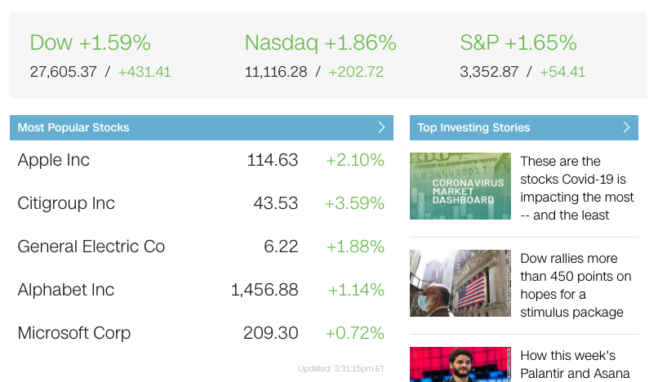
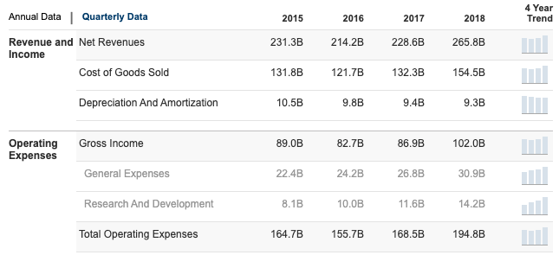
Today We Will...
Learn how much web a web scraper can scrape if a web scraper could scrape the web...
Scrape the web!

Slide 5
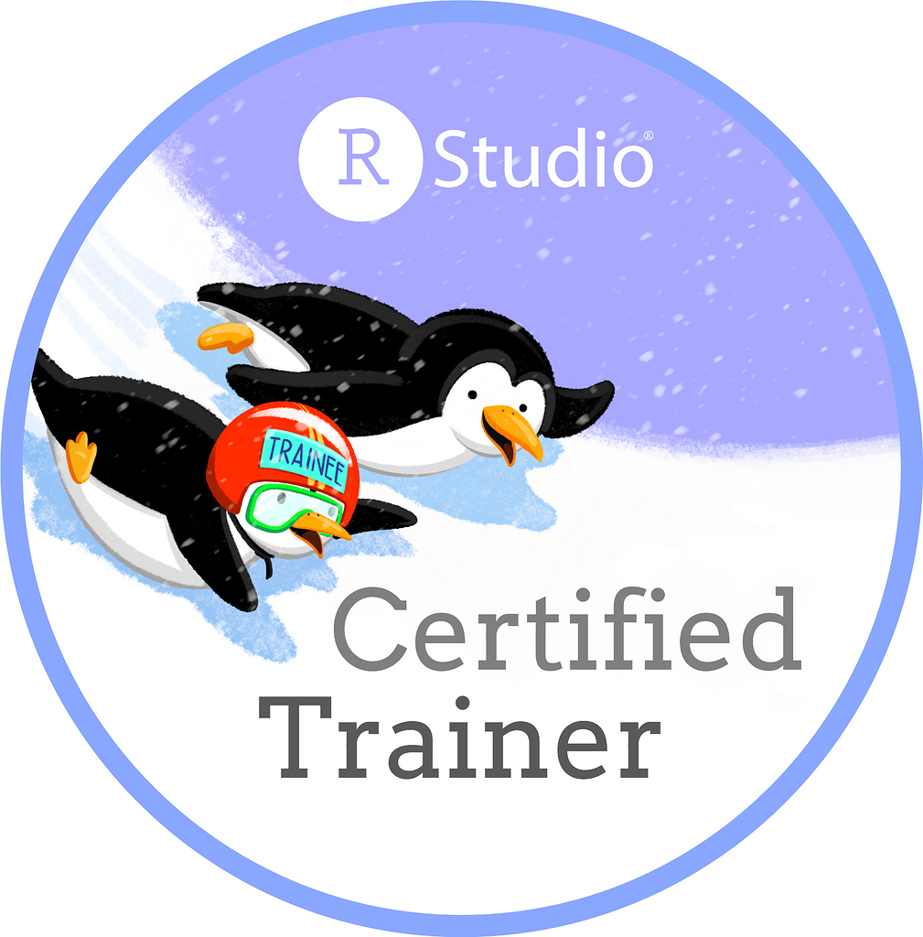
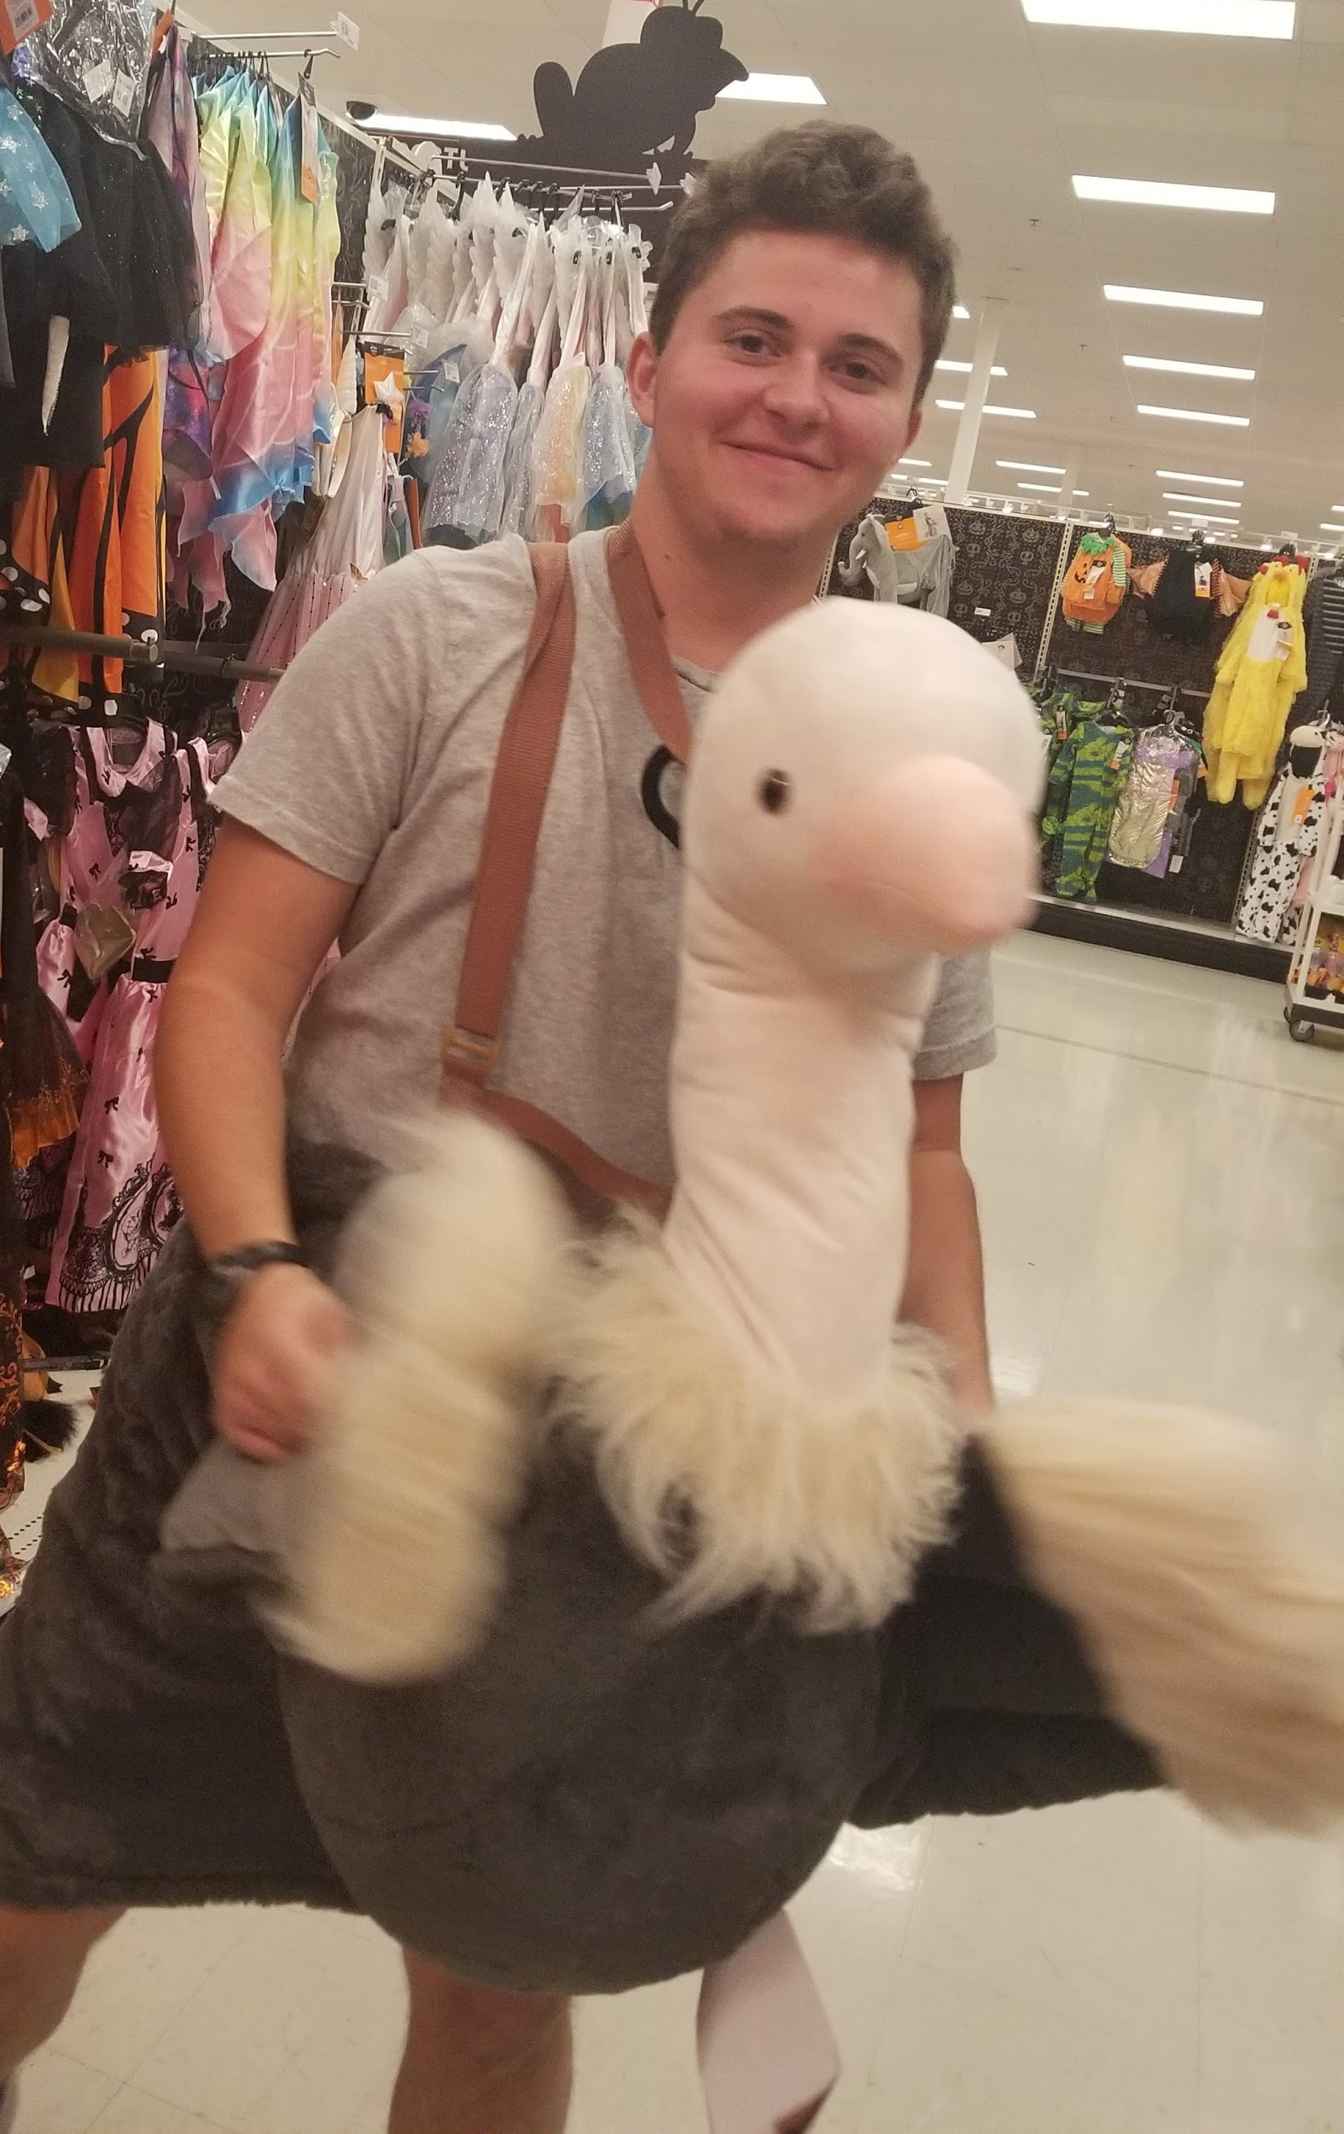

Who am I?
Leo Glowacki (he/him/his)
5th Year
Major: Data Analytics and Music
BDAA Education Director
Certified RStudio Instructor
Netflix or Youtube? Youtube
Rec: Nathaniel Drew
mental clarity, intentionality and self-development

Slide 6
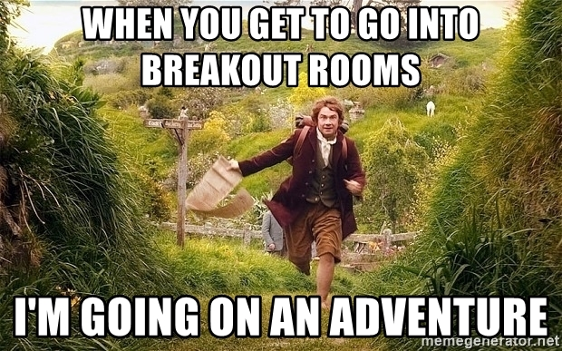
3 Min Intro Breakout Rooms
Name
Major
Year
Where are you from?
Netflix vs. Youtube?
Recommendation?

Slide 7

What is Web Scraping?
AKA, Screen Scraping, Web Data Extraction, Web Harvesting
Copying data from the web & storing for later use

Slide 8


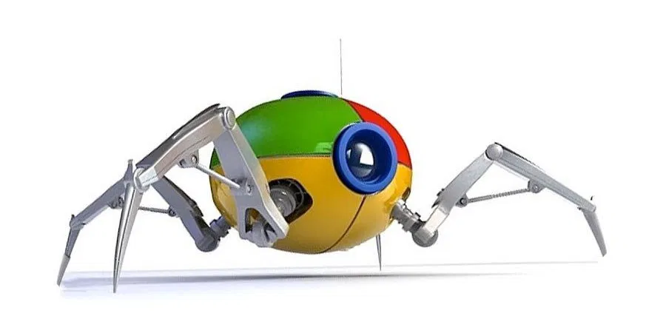
Web Scraping Uses
Competitor monitoring
Training ML models
images for classification models
Sentiment analysis, opinion mining, etc.
Data aggregation, dashboard creation
Web indexing (search engines)
Etc...
Notes:
Marketplace Sellers (e.g. amazon seller) might use web scraping to research Competitor’s prices, offers and stock availability
Data Scientists use web scraping to gather web data (like reviews, historical statistical data) to train their machine learning model

Slide 9
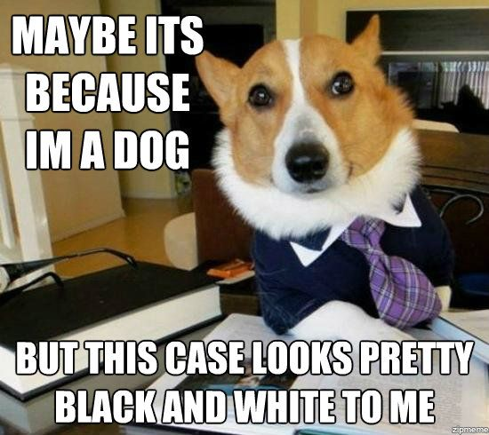
Legality
It depends
Many Terms of Service (TOS) ban it w/o permission
LinkedIn vs. HiQ
Robots.txt may ban it
Is the data copyrighted? Private or public?
What are you doing with the data later?
Legality vs. Ethics
Don't overload sites
Use data for good
Notes:
Can't actually give legal advice

Slide 10
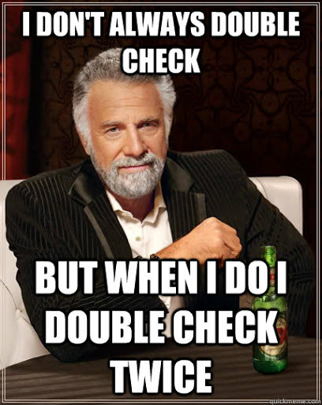
What to do before scraping
Check robots.txt
Check ToS/ToU

Slide 11

Robots.txt
Find at sitename.com/robots.txt
Allow full access
User-agent: *
Disallow:
Block all access
User-agent: *
Disallow: /
Partial access
User-agent: *
Disallow: /folder/
User-agent: *
Disallow: /file.html
Crawl rate limiting
Crawl-delay: 11
Visit time
Visit-time: 0500-1045
Notes:
https://betanews.com/2016/08/16/linkedin-sues-data-scrapers/
facebook.com
linkedin.com
TOS

Slide 12
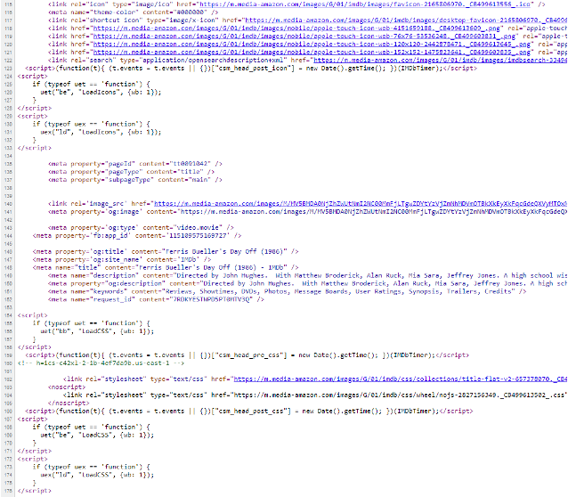
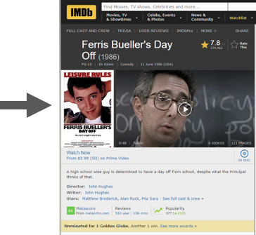
Anatomy of a Website
Notes:
Webpages: HTML + CSS + Javascript
Static vs. Dynamic content

Slide 13

Inspecting a Site with Google Chrome & Selector Gadget
https://go.osu.edu/selectorgadget
Notes:
Show google inspect
Demonstrate selector gadget

Slide 14


Web Scraping Steps
Check legality
Robots.txt
ToS/ToU
Inspect webpage
Static or dynamic?
Choose Tools
Assuming static: R library rvest is pretty good
Assuming static: Fetch the webpage
Assuming static: Parse the html
Any post-processing steps
data cleaning, data export, etc….

Slide 15
rvest
"Easily Harvest (Scrape) Web Pages"
rvest.tidyverse.org/

Slide 16

Get the R Code
Go to this link: https://go.osu.edu/scraping_code
Sign in or create account
Join Space
Click "Projects" at the top
Select the "Web Scraping" Project
Wait for project to deploy
Select "WebScraping.Rmd" (bottom right)
Notes:
R is a programming language
You can program R in RStudio/RStudio Cloud
Name parts in RStudio
Knitting gets your results
Load times- be patient, don't refresh
Ensure no pop up blockers preventing RMarkdown

Slide 17
A potential alternative to web scraping… APIs
Same goal as web scraping - get the data
APIs can also interact with the system
Usually register w/service & make calls to it that are followed by a response
Pros:
Formatting is usually easier
Usually legal if/when scraping is not
Easier when interaction is necessary
Cons:
Not all websites/services have APIs
Data not always current
Rate limits

Slide 18
Sites for More Practice
thelantern.com
wikipedia.org
weather.com
bbc.com
toscrape.com
cnn.com
foxnews.com

Slide 19
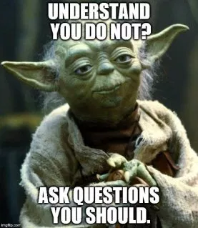
Questions?
Any Questions?
BDAA Slack R Learning Community!
go.osu.edu/bdaaslack
Feedback:
go.osu.edu/scraping_feedback
My Contact Info:
Leo Glowacki
Message me on Slack!
www.LeoGlowacki.com

